Slide 1



ADD
Team 4

Slide 2
OVERVIEW
Pango Blocks is a logic game for toddlers designed for mobile devices, in which the player has to build a path with different types of blocks for Pango, a raccoon, that needs to reach an item to give to another character.
The game has a cartoon style.
ADD
Team 4

Slide 3
CHARACTERS
ADD
Team 4

Slide 4

PANGO
Pango is the main character, a blue raccoon.
Sara Gandini, Letizia Pesce

Slide 5

PIGGY
Sara Gandini, Letizia Pesce

Slide 6
GOAL ITEMS
In every level Pango needs to reach and collect a different item in order to complete the stage and unlock the cutscene
ADD
Team 4

Slide 7





Paolo Rizzo

Slide 8
BLOCKS
To reach the items the player needs to use different types of blocks to build a path for Pango.
ADD
Team 4

Slide 9






Nicole Avanzi

Slide 10

Paolo Rizzo

Slide 11
TERRAIN BLOCKS
ADD
Team 4

Slide 12






Paolo Rizzo

Slide 13







Manuel Esposito

Slide 14
UI
ADD
Team 4

Slide 15


Paolo Rizzo

Slide 16








Paolo Rizzo

Slide 17








Paolo Rizzo

Slide 18



Nicole Avanzi

Slide 19









Federico Agosti

Slide 20
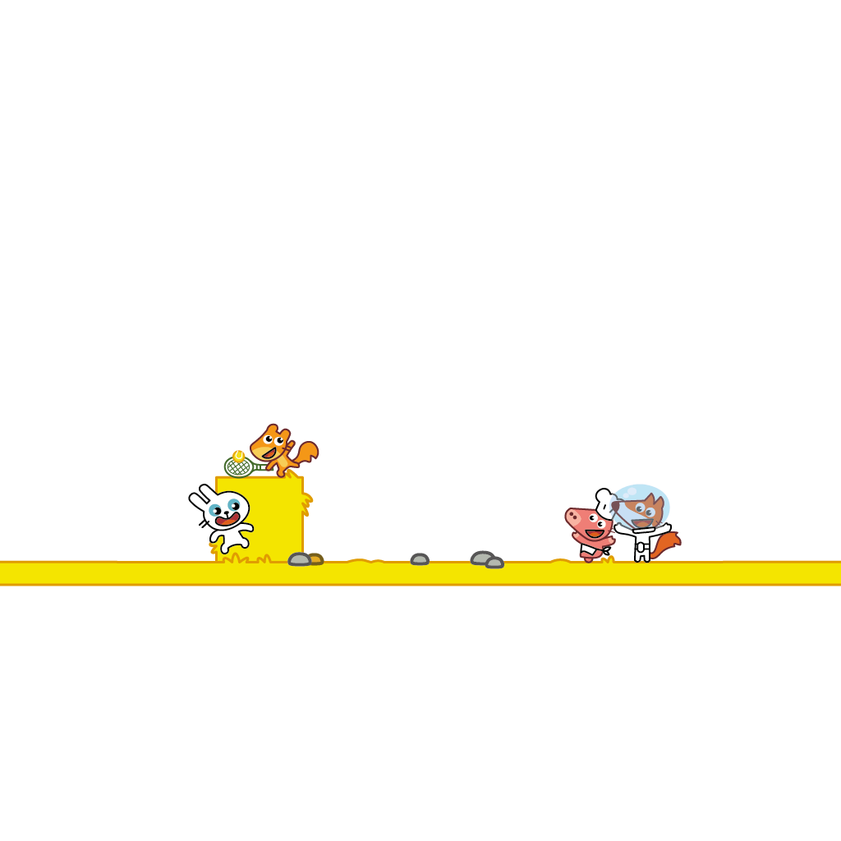





Federico Agosti

Slide 21





Federico Agosti

Slide 22




Marika Schiavi

Slide 23
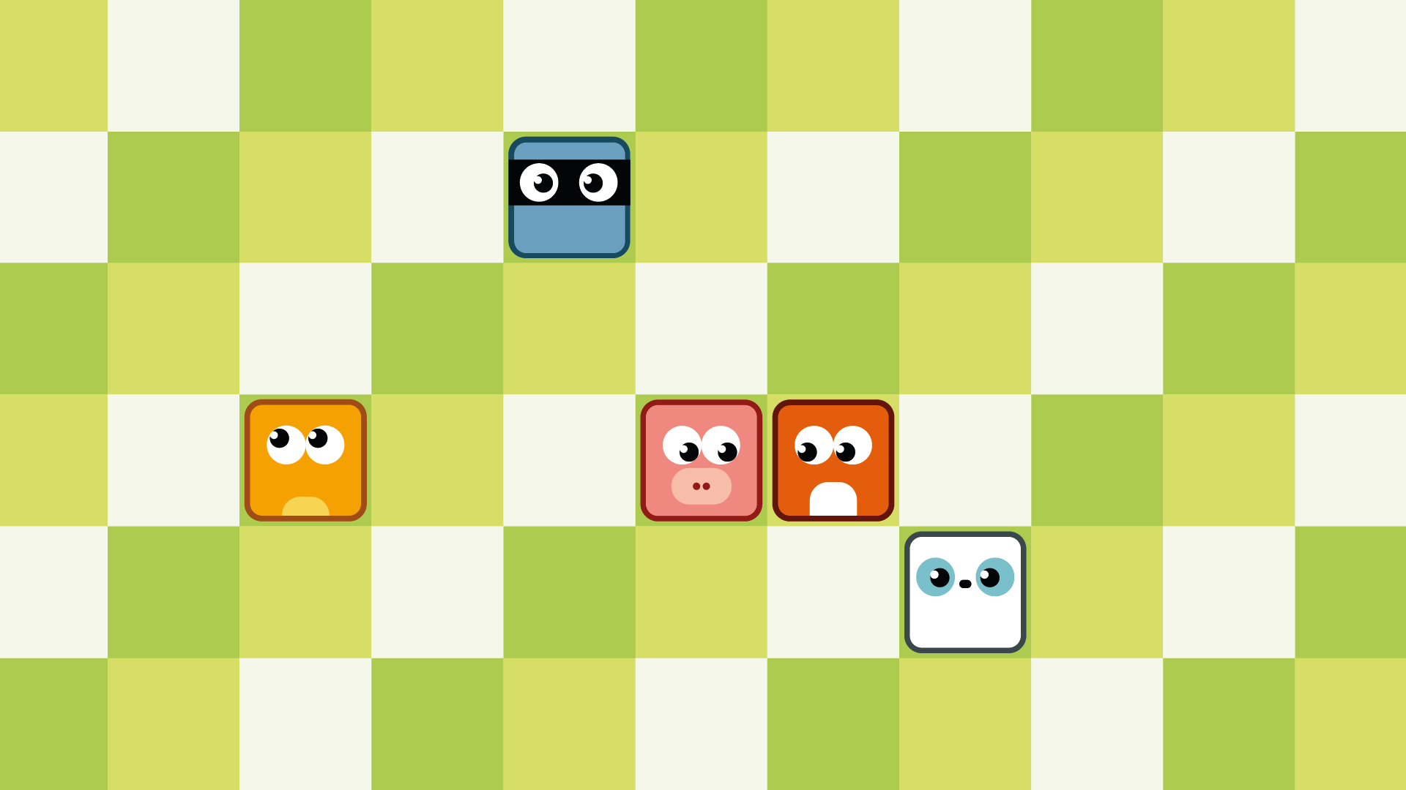
Federico Agosti

Slide 24





Federico Agosti

Slide 25
BACKGROUND
ADD
Team 4

Slide 26

Giulia Timeo

Slide 27
ANIMATIONS
ADD
Team 4

Slide 28


Drawing: Sara Gandini
Animation: Letizia Pesce

Slide 29


Drawing: Sara Gandini
Animation: Letizia Pesce

Slide 30


Drawing: Sara Gandini
Animation: Letizia Pesce

Slide 31


Drawing: Sara Gandini
Animation: Letizia Pesce

Slide 32


Drawing: Sara Gandini
Animation: Letizia Pesce

Slide 33
CUTSCENE
ADD
Team 4

Slide 34

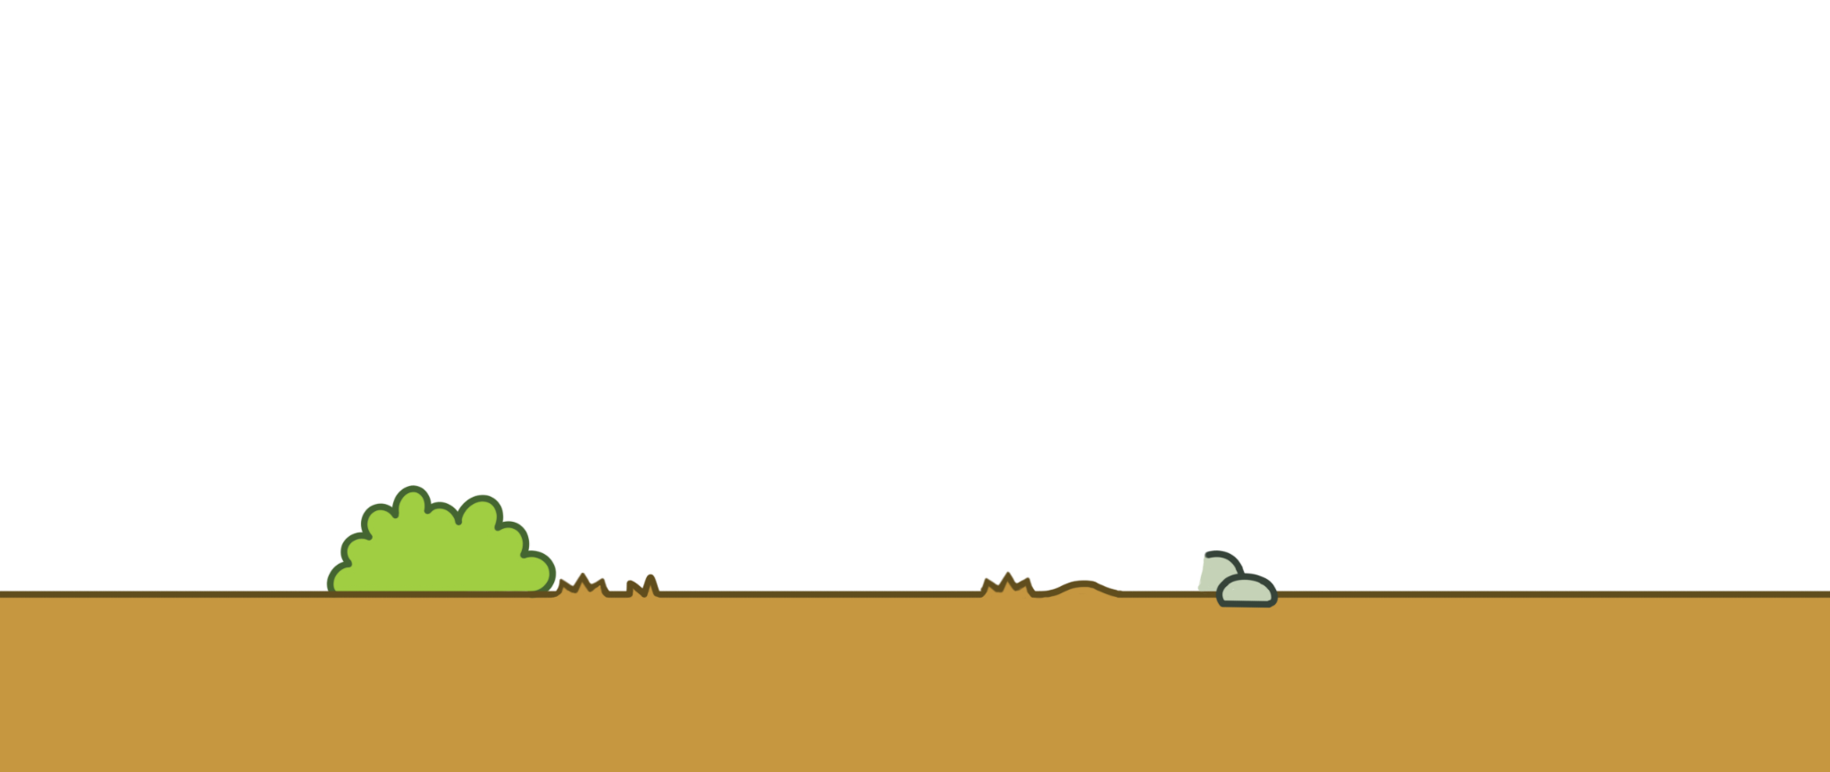
Sara Gandini

Slide 35


Sara Gandini

Slide 36


Drawing: Sara Gandini
Animation: Letizia Pesce, Giulia Timeo

Slide 37


Drawing: Sara Gandini
Animation: Giulia Timeo

Slide 38

Drawing: Paolo Rizzo, Giulia Timeo
Animation: Giulia Timeo

Slide 39


Giulia Timeo

Slide 40
STAGE 2 - EUROPE
ADD
Team 4

Slide 41
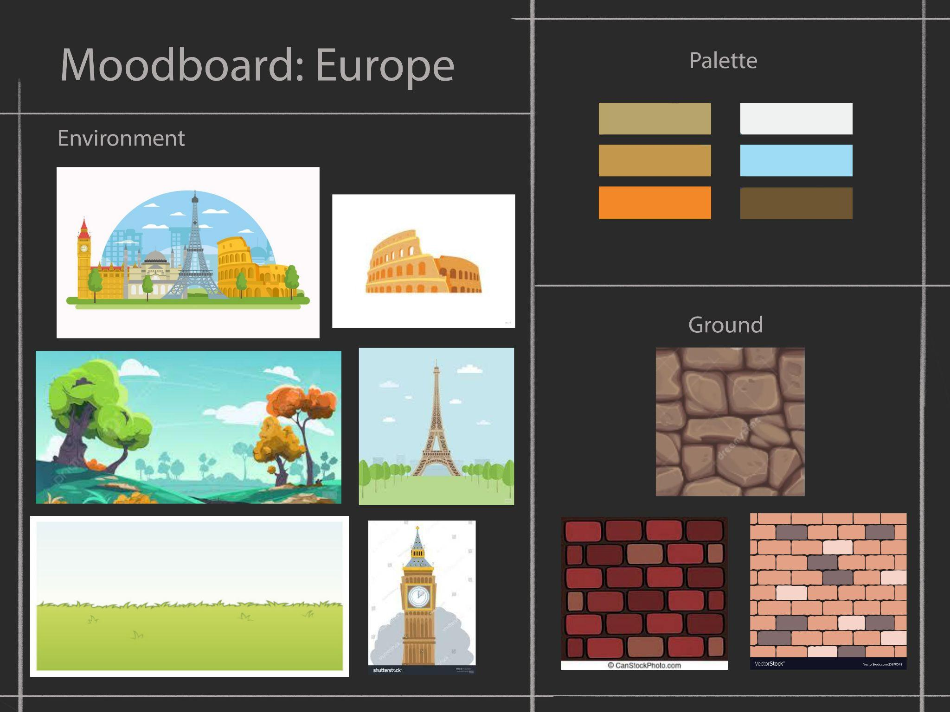
Giulia Timeo

Slide 42
CHARACTERS
ADD
Team 4

Slide 43


Sara Gandini, Federico Agosti

Slide 44
ITEMS
ADD
Team 4

Slide 45




Marika Schiavi

Slide 46




Sara Gandini, Federico Agosti

Slide 47
TERRAIN BLOCKS
ADD
Team 4

Slide 48






Paolo Rizzo

Slide 49
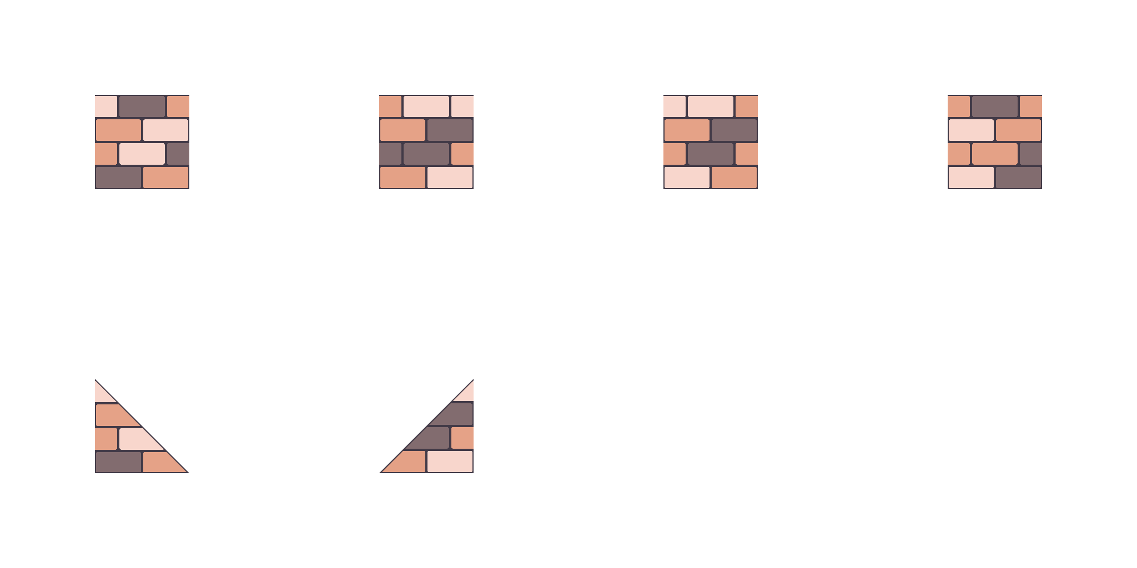
Manuel Esposito

Slide 50
UI
ADD
Team 4

Slide 51








Paolo Rizzo

Slide 52








Paolo Rizzo

Slide 53
BACKGROUND
ADD
Team 4

Slide 54

Giulia Timeo

Slide 55
ANIMATIONS
ADD
Team 4

Slide 56


Drawing: Sara Gandini
Animation: Letizia Pesce

Slide 57


Drawing: Sara Gandini
Animation: Letizia Pesce

Slide 58


Drawing: Sara Gandini
Animation: Letizia Pesce

Slide 59


Drawing: Sara Gandini
Animation: Letizia Pesce, Giulia Timeo

Slide 60


Drawing: Sara Gandini
Animation: Francesco Rindone, Letizia Pesce

Slide 61
CUTSCENE
ADD
Team 4

Slide 62


Federico Agosti

Slide 63

Marika Schiavi & Federico Agosti

Slide 64

Marika Schiavi & Federico Agosti

Slide 65
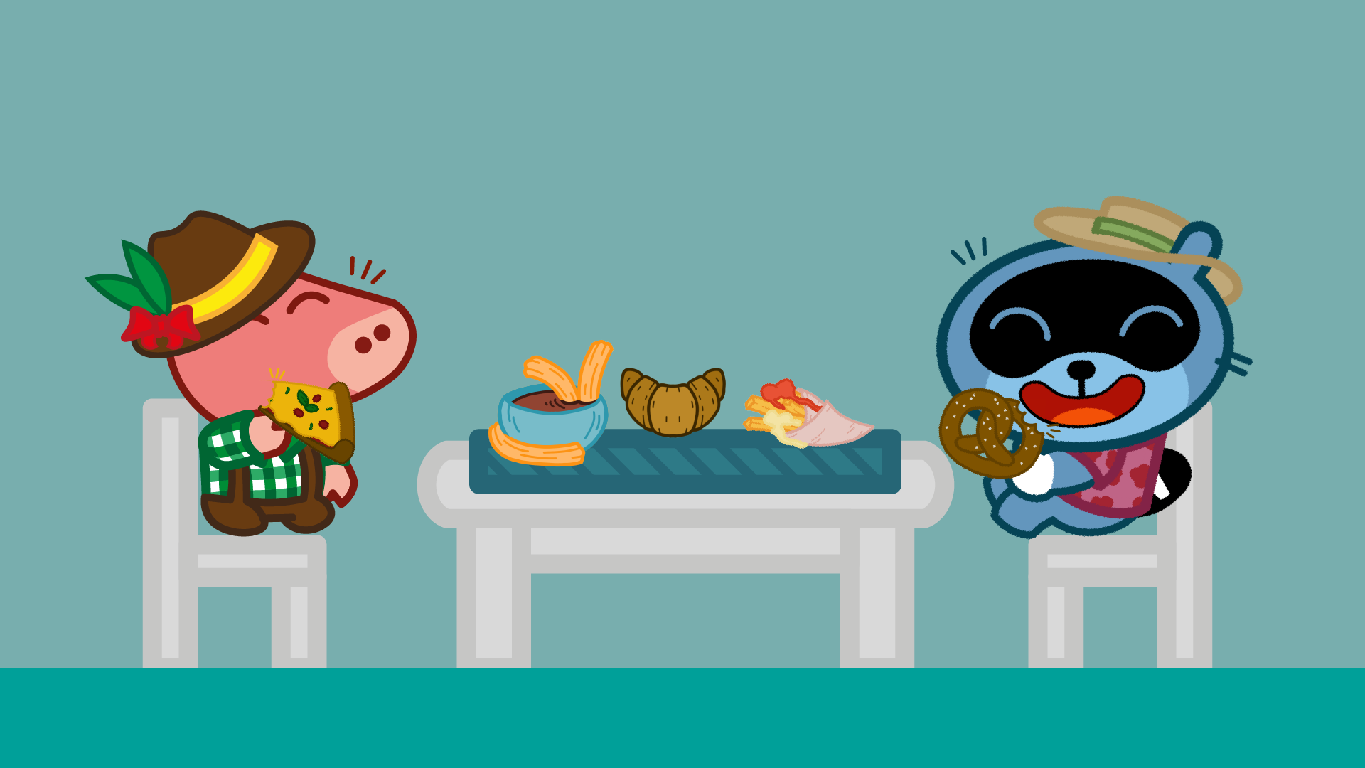
Marika Schiavi & Federico Agosti

Slide 66
STAGE 3 - ASIA
ADD
Team 4

Slide 67
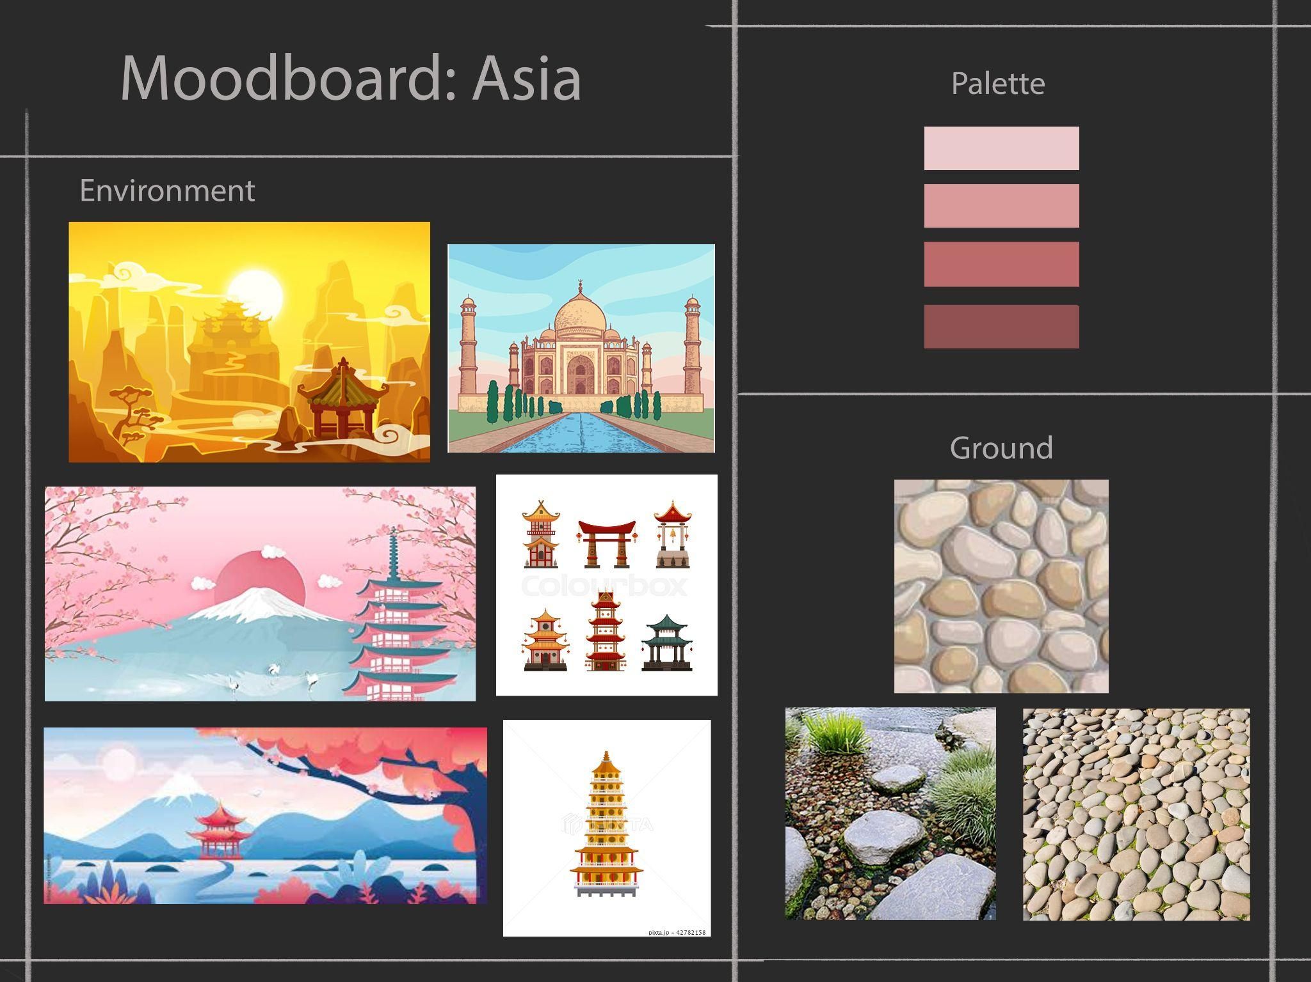
Giulia Timeo

Slide 68
CHARACTER
ADD
Team 4

Slide 69

Marika Schiavi

Slide 70
ITEMS
ADD
Team 4

Slide 71








Paolo Rizzo

Slide 72
TERRAIN BLOCKS
ADD
Team 4

Slide 73






Paolo Rizzo

Slide 74
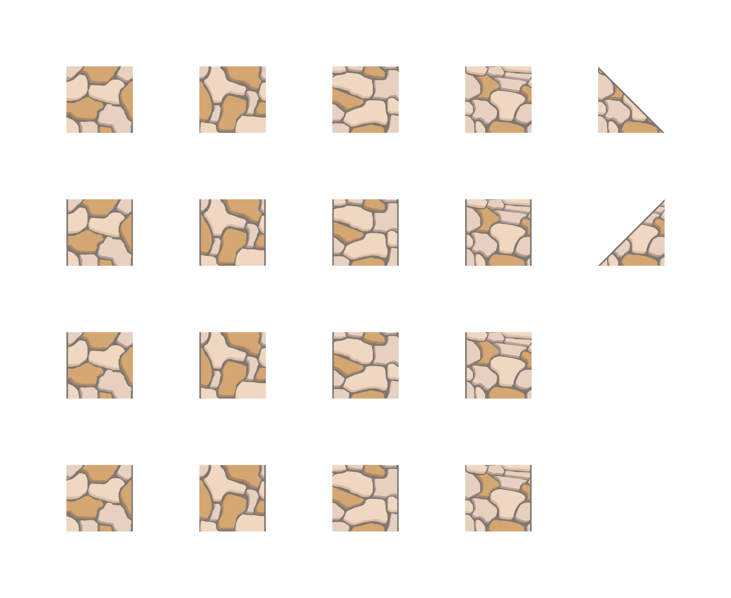
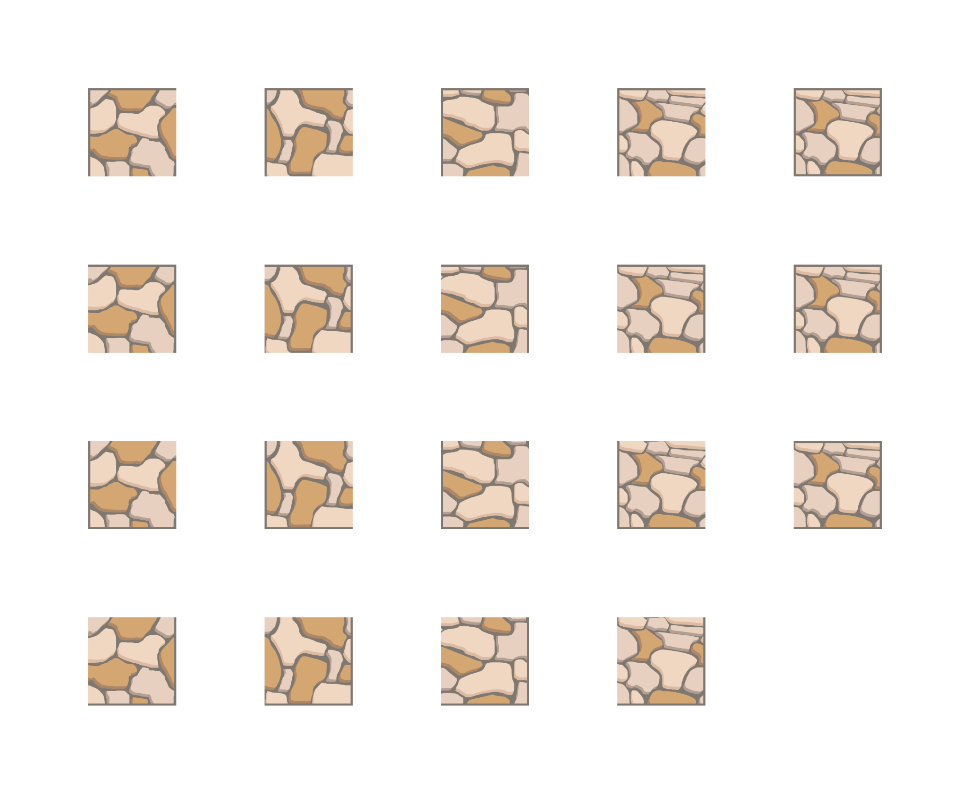
Manuel Esposito

Slide 75
UI
ADD
Team 4

Slide 76








Paolo Rizzo

Slide 77








Paolo Rizzo

Slide 78
BACKGROUND
ADD
Team 4

Slide 79

Marika Schiavi

Slide 80
CUTSCENE
ADD
Team 4

Slide 81

Nicole Avanzi

Slide 82

Marika Schiavi & Federico Agosti

Slide 83
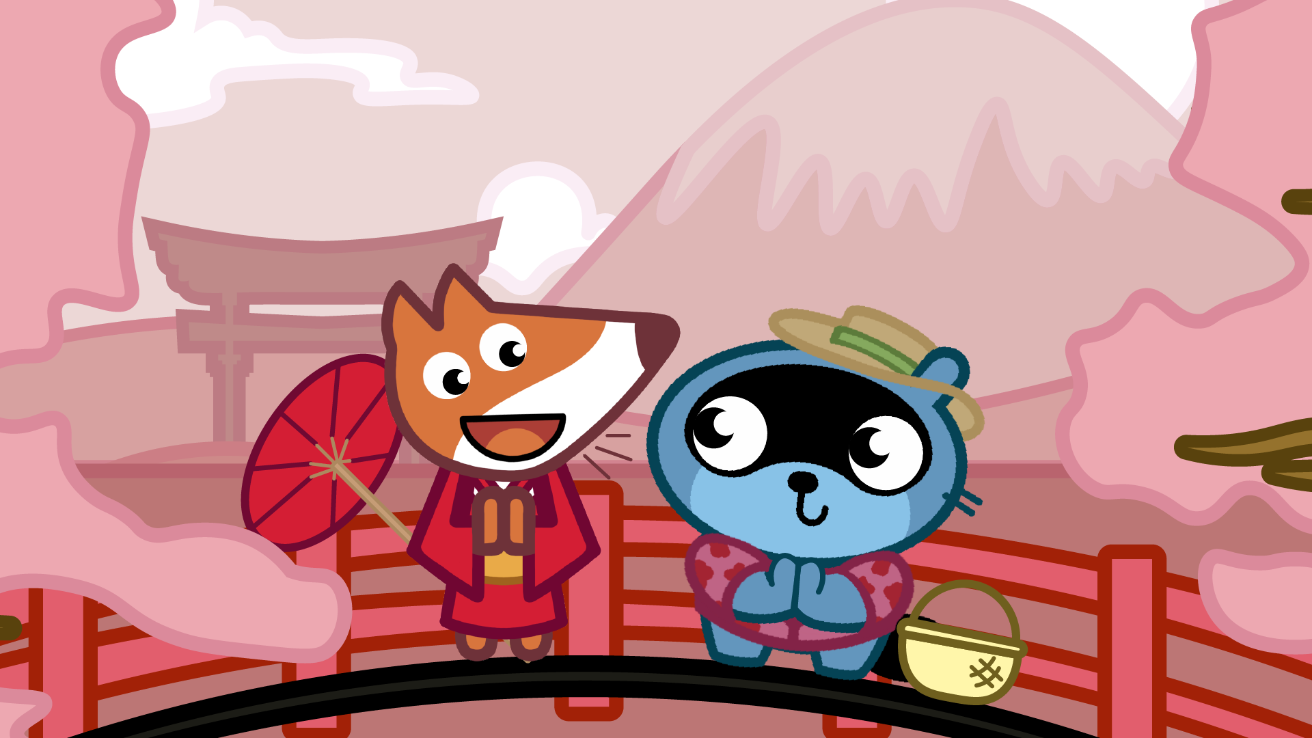
Marika Schiavi & Federico Agosti

Slide 84

Marika Schiavi & Federico Agosti

Slide 85
STAGE 4 - AFRICA
ADD
Team 4

Slide 86
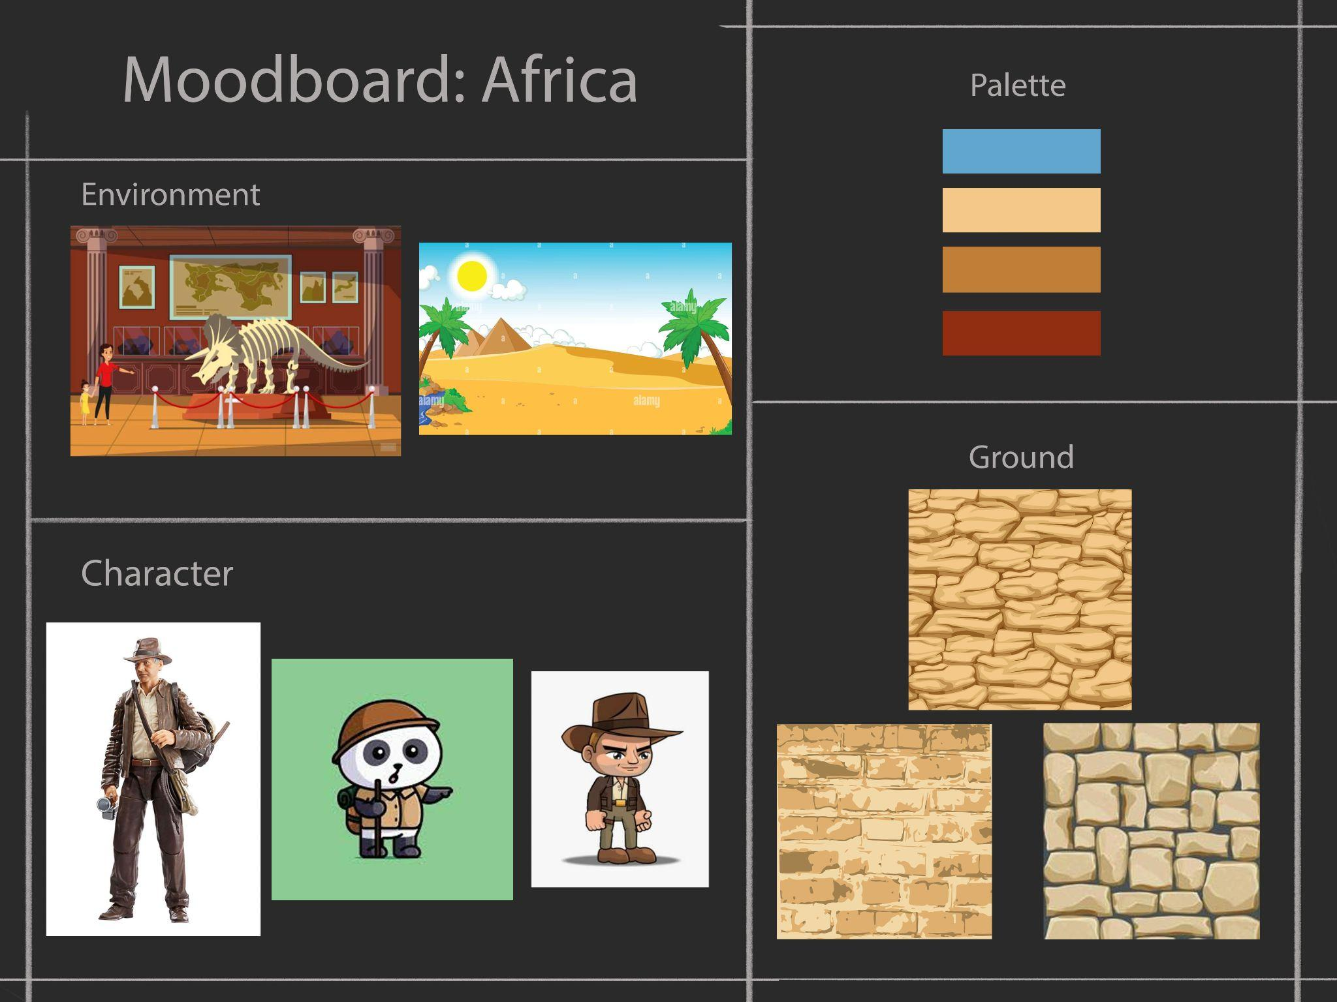
Giulia Timeo

Slide 87
CHARACTER
ADD
Team 4

Slide 88

Marika Schiavi

Slide 89
ITEMS
ADD
Team 4

Slide 90








Paolo Rizzo

Slide 91
TERRAIN BLOCKS
ADD
Team 4

Slide 92







Paolo Rizzo

Slide 93
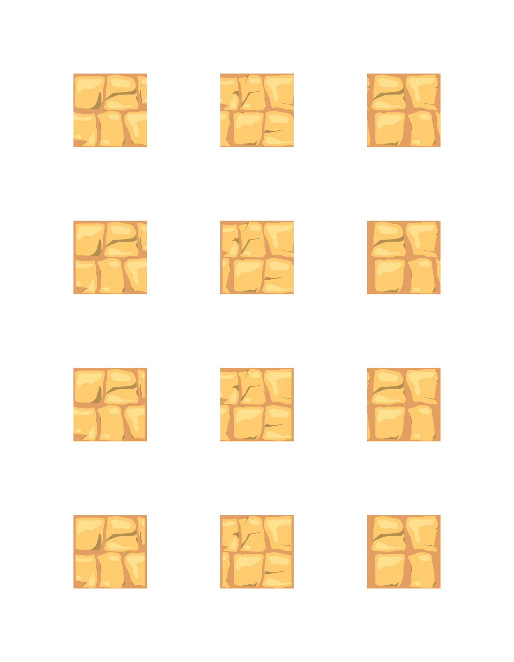
Manuel Esposito

Slide 94
UI
ADD
Team 4

Slide 95








Paolo Rizzo

Slide 96








Paolo Rizzo

Slide 97
BACKGROUND
ADD
Team 4

Slide 98

Marika Schiavi

Slide 99
CUTSCENE
ADD
Team 4

Slide 100


Federico Agosti

Slide 101

Marika Schiavi & Federico Agosti

Slide 102
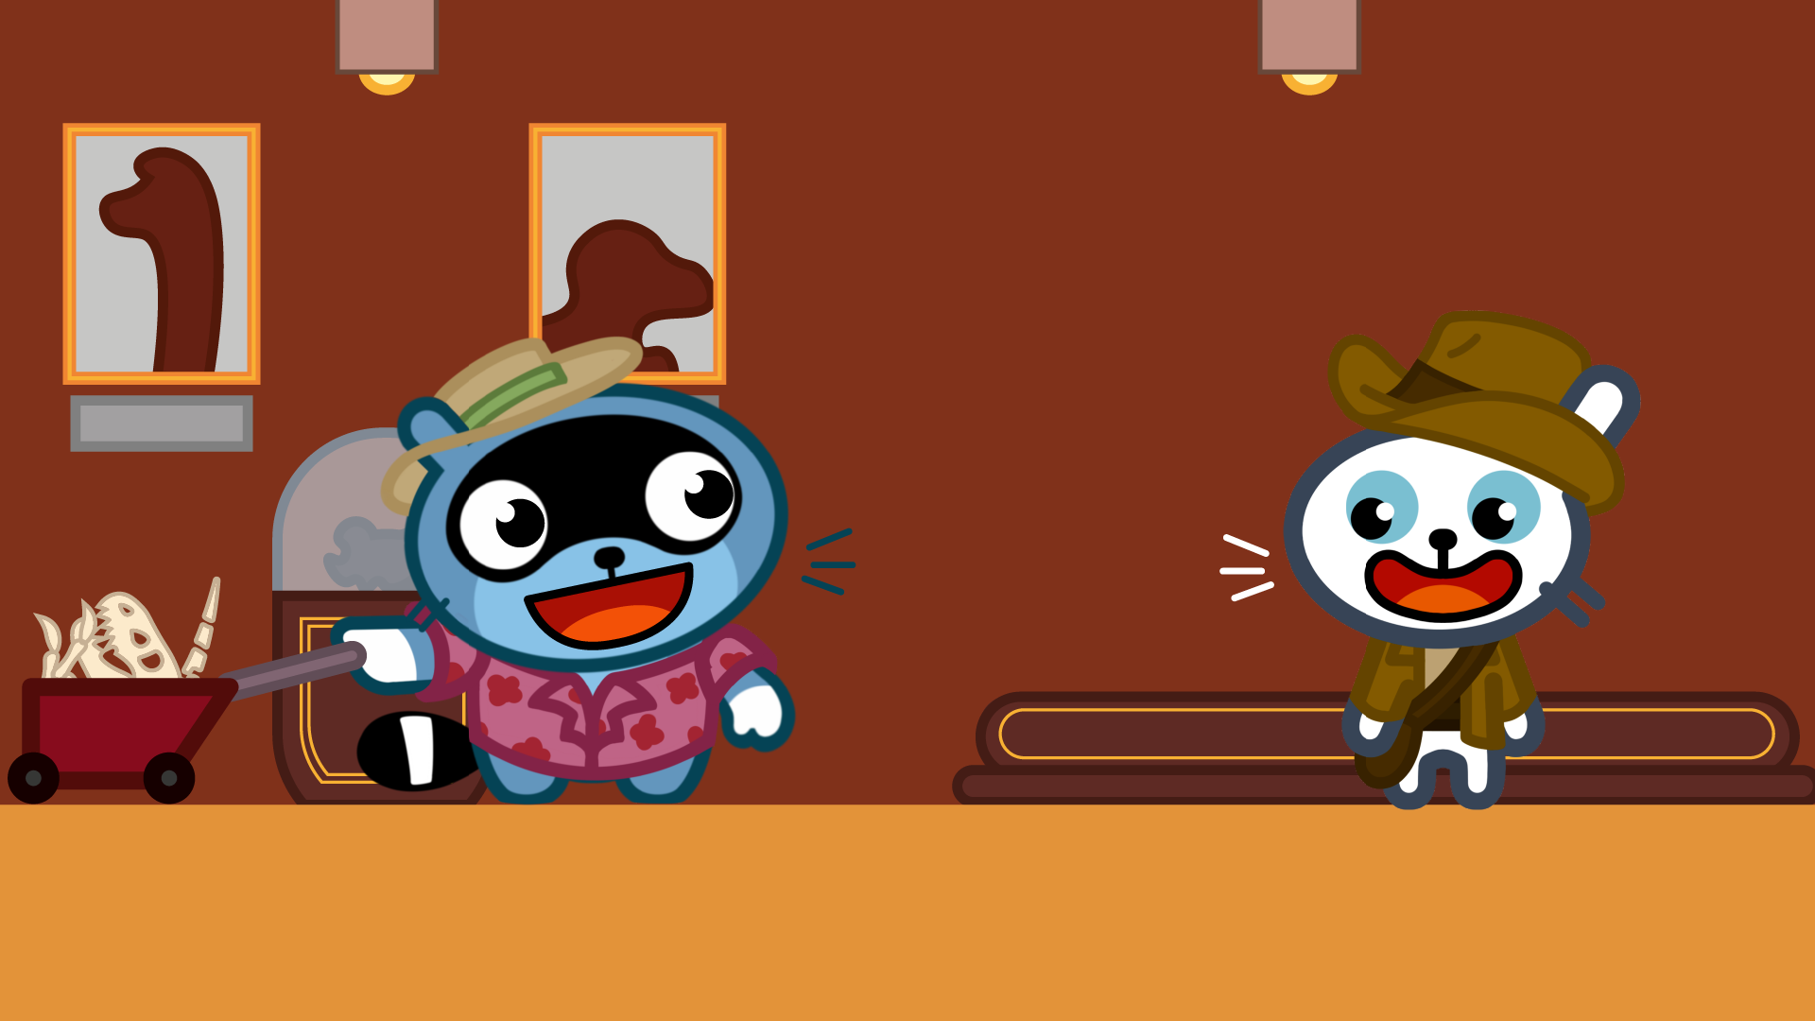
Marika Schiavi & Federico Agosti

Slide 103
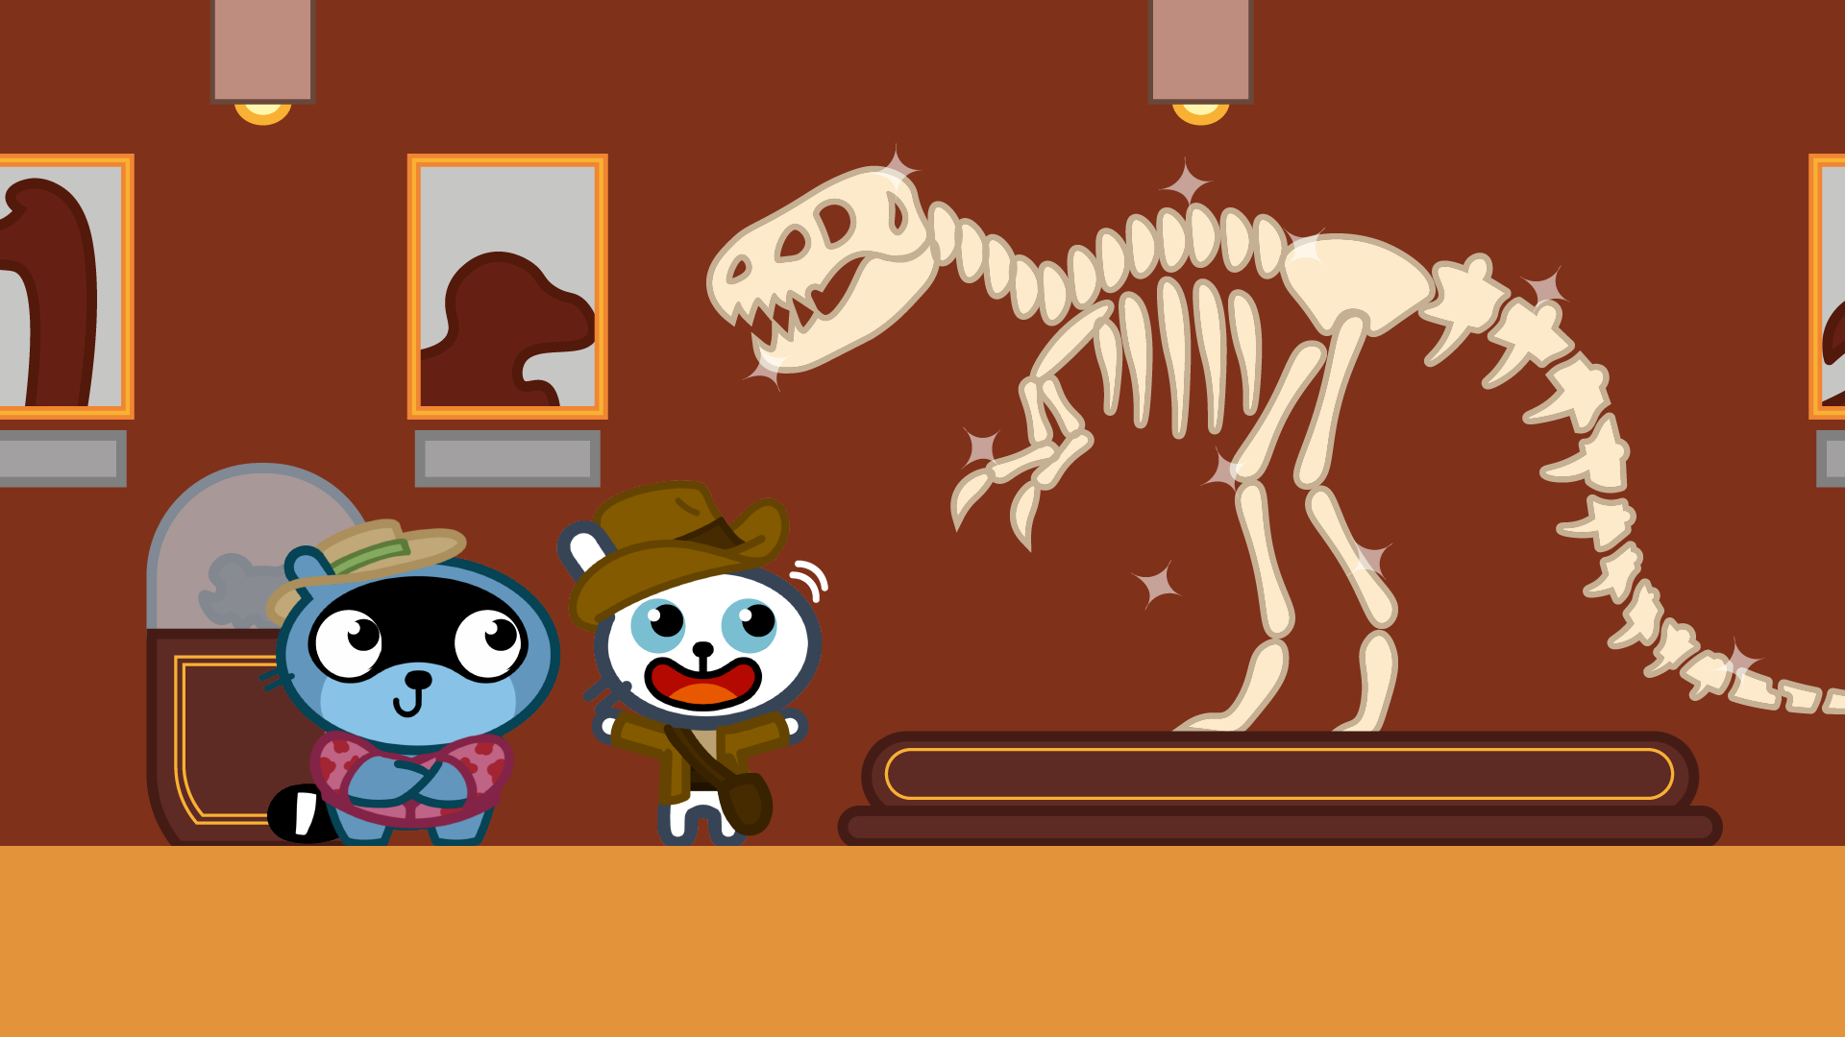
Marika Schiavi & Federico Agosti

Slide 104
STAGE 5 - ANTARCTICA
ADD
Team 4

Slide 105
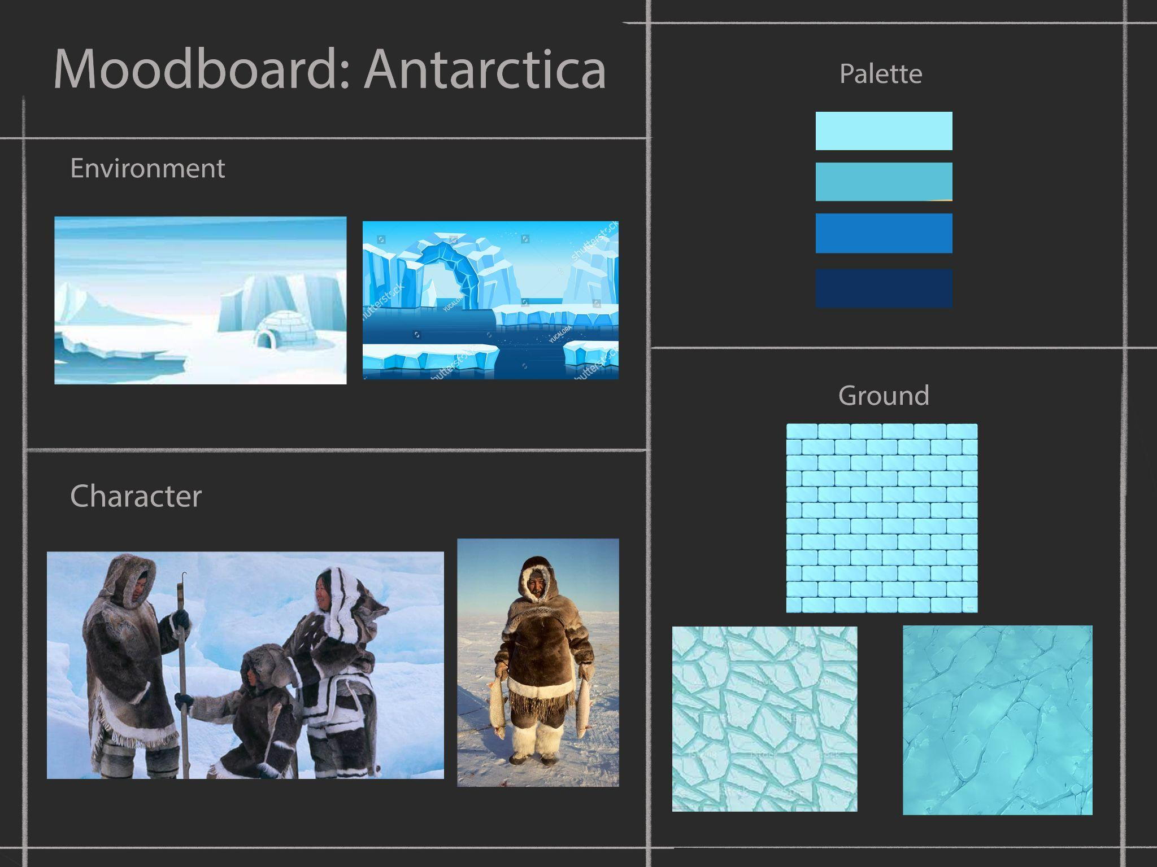
Giulia Timeo

Slide 106
CHARACTER
ADD
Team 4

Slide 107

Marika Schiavi

Slide 108
ITEMS
ADD
Team 4

Slide 109








Paolo Rizzo

Slide 110
TERRAIN BLOCKS
ADD
Team 4

Slide 111







Paolo Rizzo

Slide 112


Manuel Esposito

Slide 113
UI
ADD
Team 4

Slide 114









Paolo Rizzo

Slide 115
BACKGROUND
ADD
Team 4

Slide 116

Marika Schiavi

Slide 117
CUTSCENE
ADD
Team 4

Slide 118


Federico Agosti

Slide 119

Marika Schiavi & Federico Agosti

Slide 120

Marika Schiavi & Federico Agosti

Slide 121
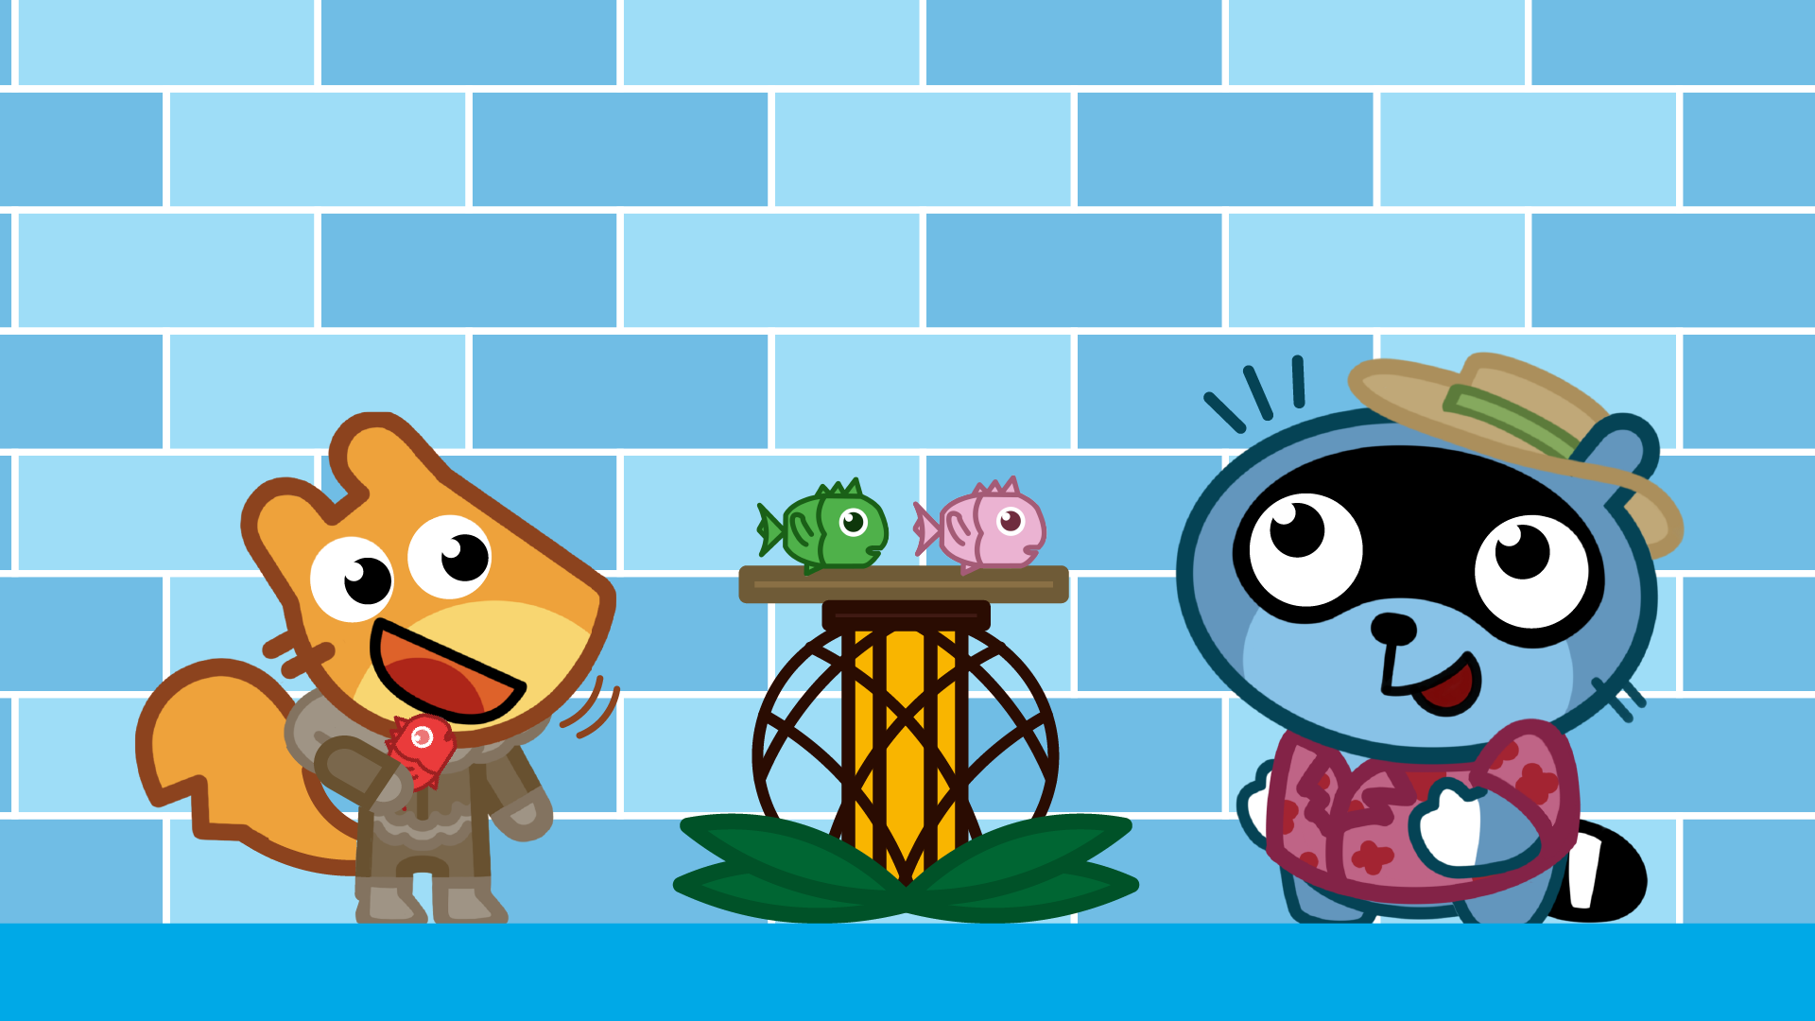
Marika Schiavi & Federico Agosti

Slide 122
TEAM 4 - PANGO BLOCKS
Artist:
Agosti Federico
Avanzi Nicole
Esposito Manuel
Gandini Sara
Pesce Letizia
Rizzo Paolo
Schiavi Marika Timeo Giulia
ADD
Team 4

